Slide 1
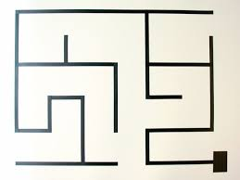
Line maze solving bot

Slide 2
OUTLINE
What is line maze ?
How to solve line maze : Alogrithm.

Slide 3
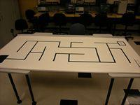
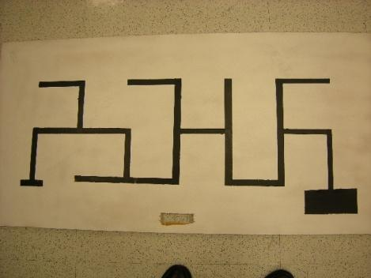
What is a Line Maze?
A line maze is usually a black line on a white background. It could also be a white line on a black background, but for this presentation black lines on a white background will be used.

Slide 4
What is Line Maze
There are many dead ends.
One start point and one end point.
generally Path is made with black line on white background.

Slide 5
what is this compitition?
Compitition : here you need to make a robot . Robot will solve the maze and you will win.
Dry Run: In first chance you need to run your robot and it will take multiple
wrong turns and finally reach the end of the maze .
Final Run : Now put your robot on starting point and now it will cover the
shortest path to reach the final point .
Winner : robot which will take less time to reach final point in Final Run.

Slide 6
Working of robot
Robot is having some short of intelligence.
This a special algorithm based of practical experience of humans.
What will you do if you are lost in a maze ?
lets see........

Slide 7
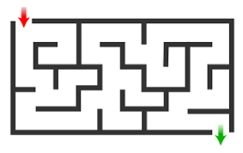
How humans solve the maze

Slide 8
Algorithm
We have 2 Algorithms:
Left hand rule Algorithm
means:
1. Always prefer a left turn over going
straight ahead or taking a right turn.
2. Always prefer going straight over going
right.
If the maze has no loops, this will always get
you to the end of the maze.

Slide 9
Algorithm.
Right Hand Rule:
The right hand rule is just the opposite:
1. Always prefer a right turn over going
straight ahead or taking a left turn.
2. Always prefer going straight over going
left.
If the maze has no loops, this will always get
you to the end of the maze.

Slide 10
Which Algorithm is best
Both algorithm takes same time and space so, it dosent mattter both are same .
We will you left hand rule in this presenstation.

Slide 11
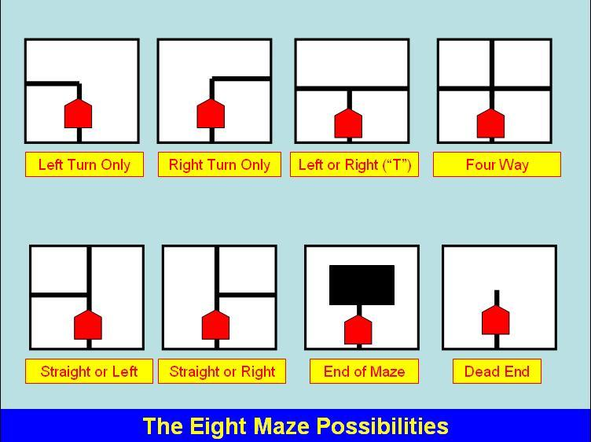
Left hand Rule Algorithm
The 8 Possiblities:
Given a maze with no loops, there are only 8 possible situations that the robot can encounter.
we will come to this later.

Slide 12
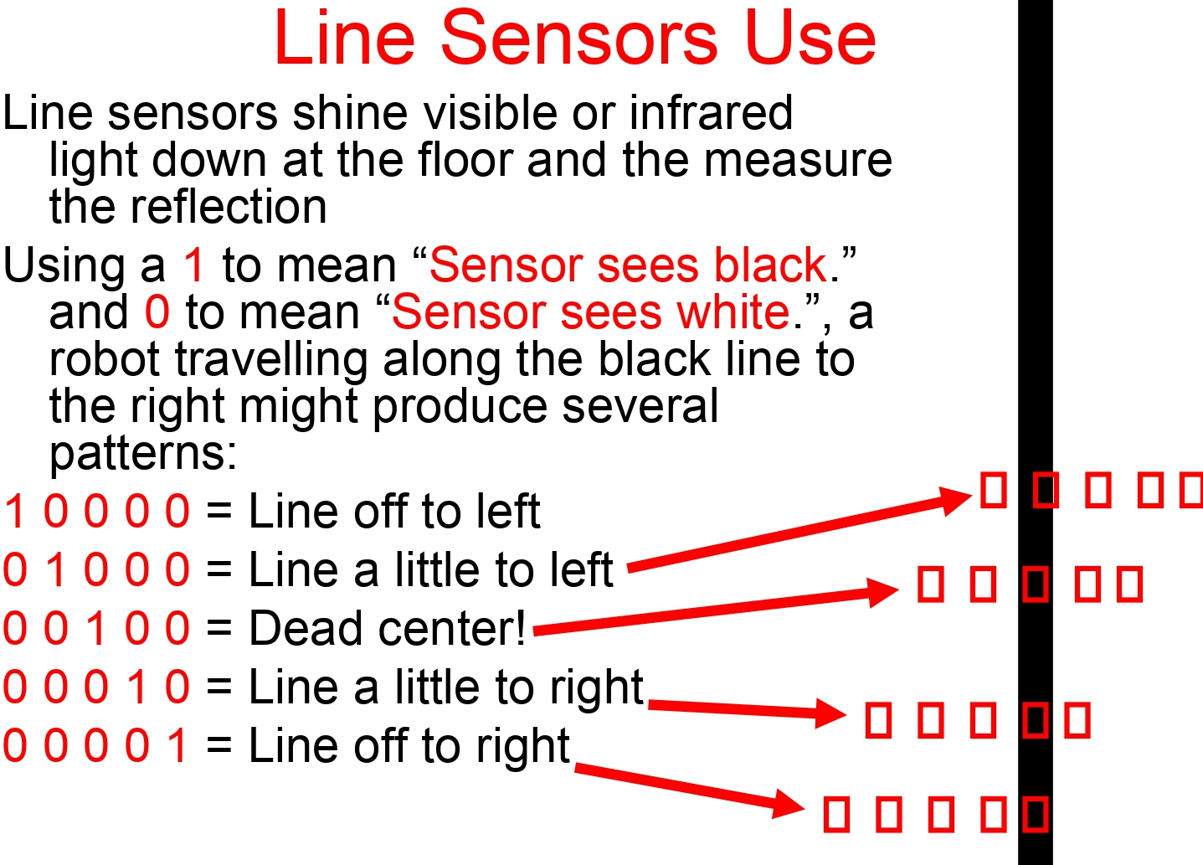
Left hand Rule Algorithm

Slide 13
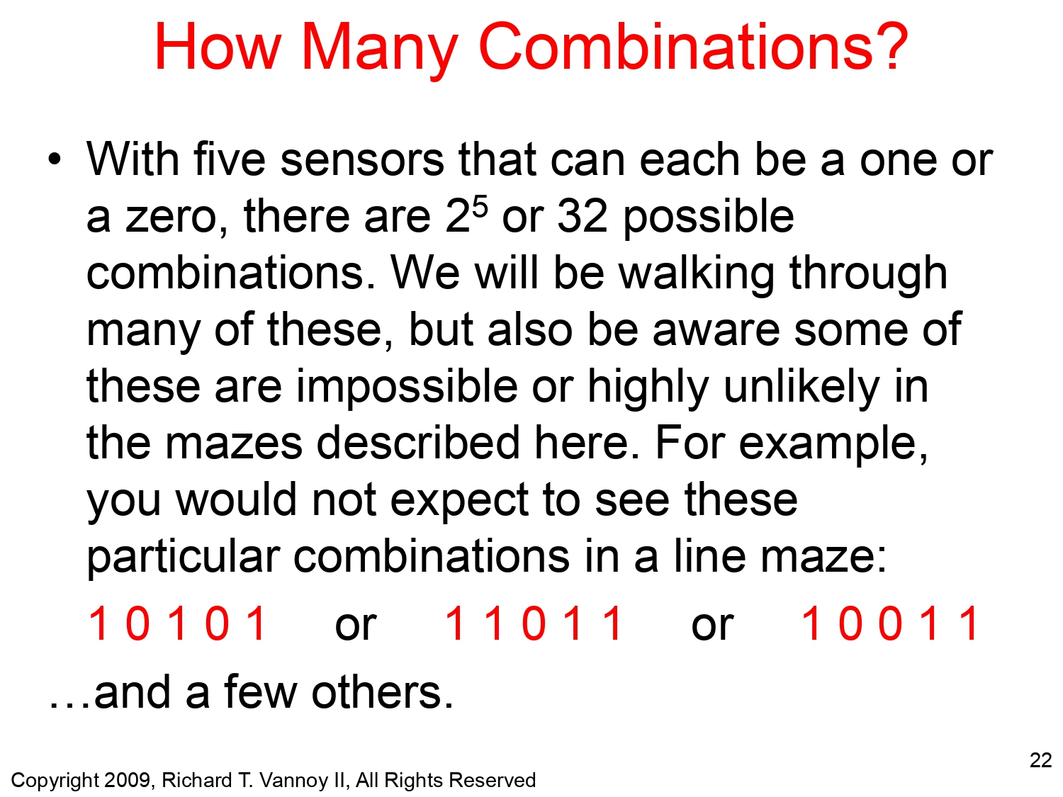
Left hand Rule Algorithm

Slide 14
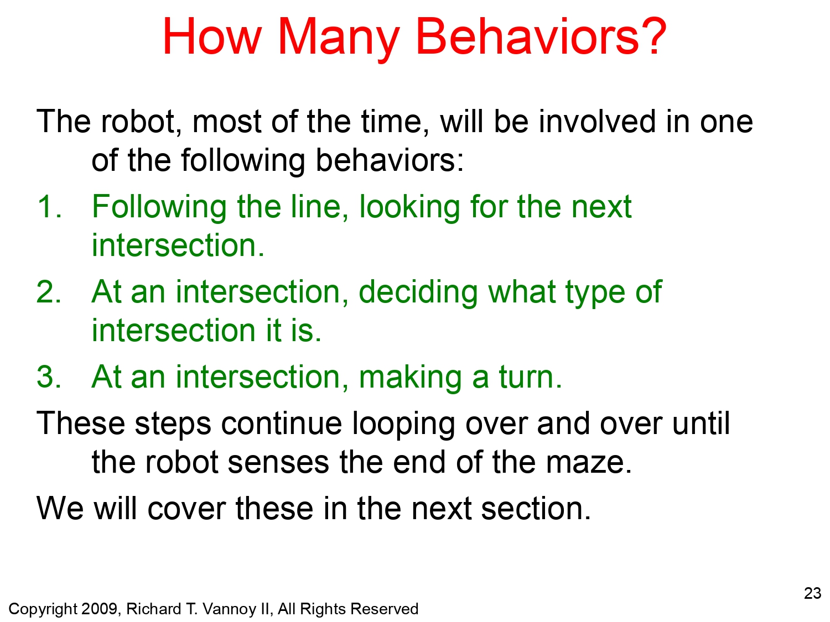
Left hand Rule Algorithm

Slide 15
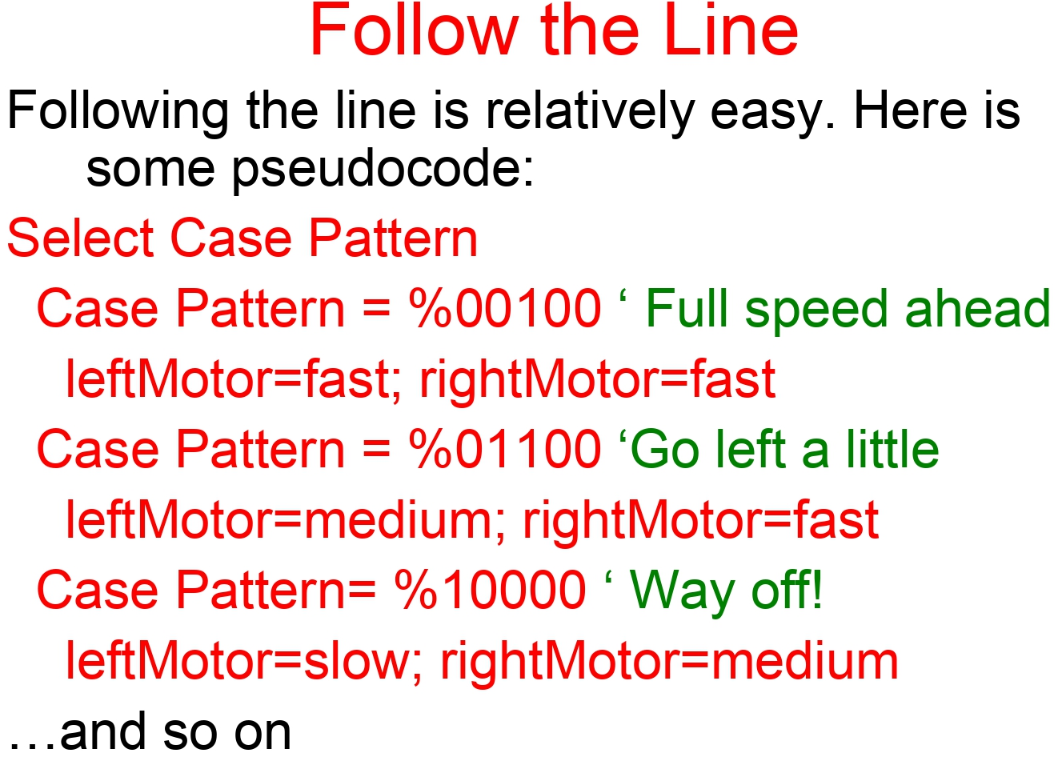
Left hand Rule Algorithm

Slide 16
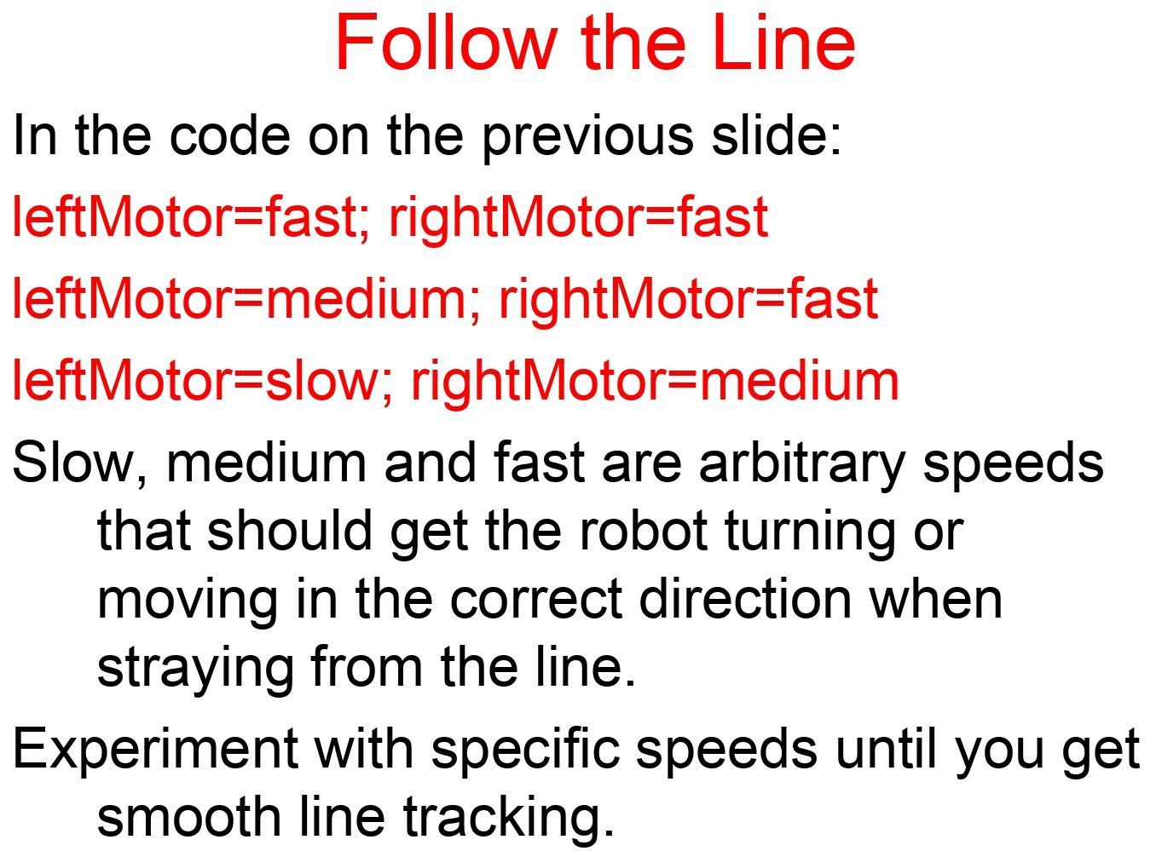
Left hand Rule Algorithm

Slide 17
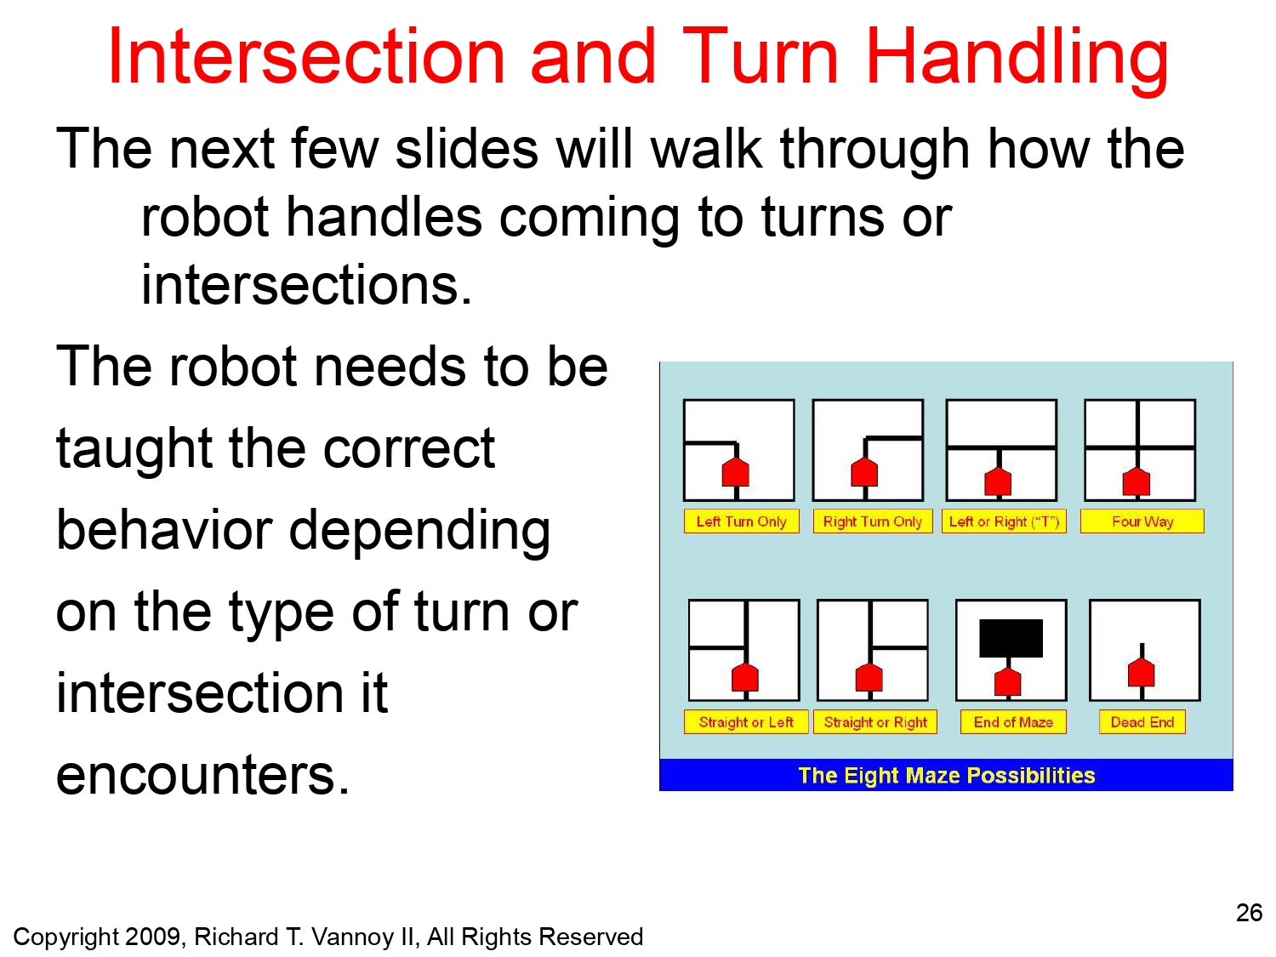
Left hand Rule Algorithm

Slide 18
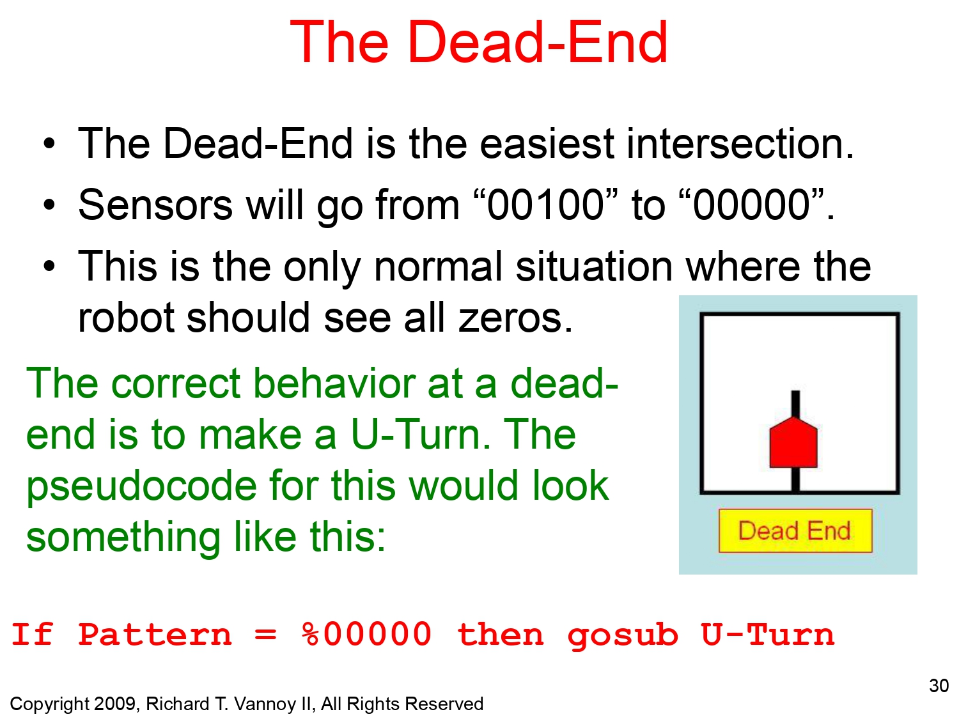
Left hand Rule Algorithm

Slide 19
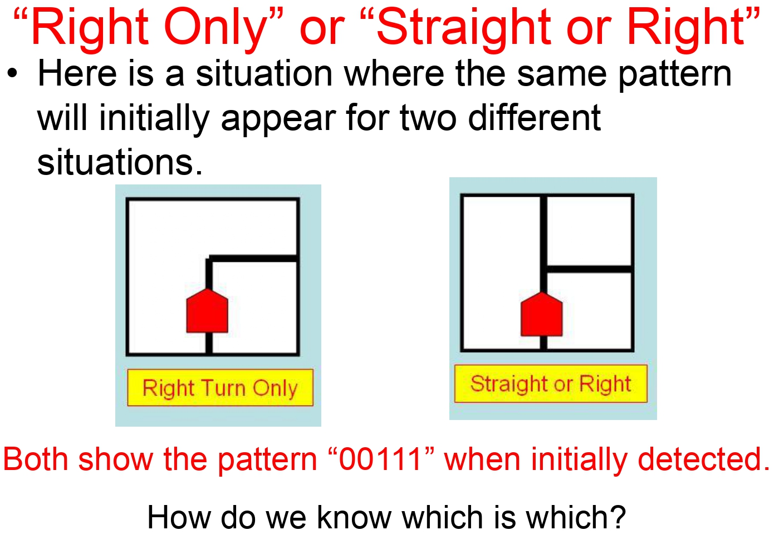
Left hand Rule Algorithm

Slide 20
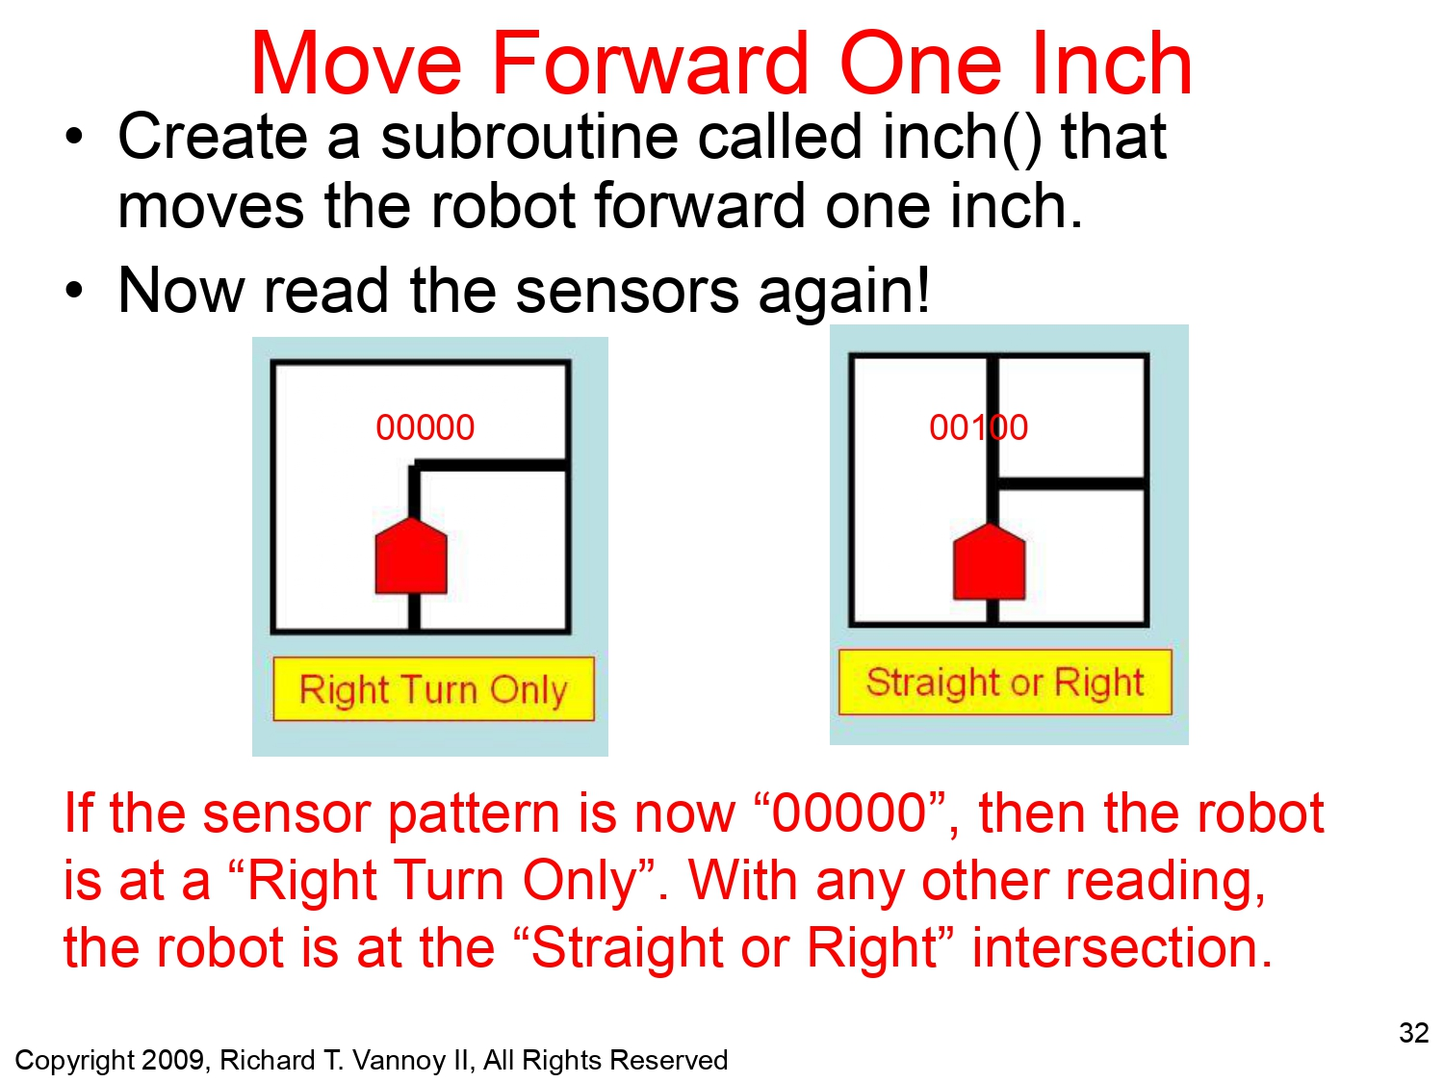
Left hand Rule Algorithm

Slide 21
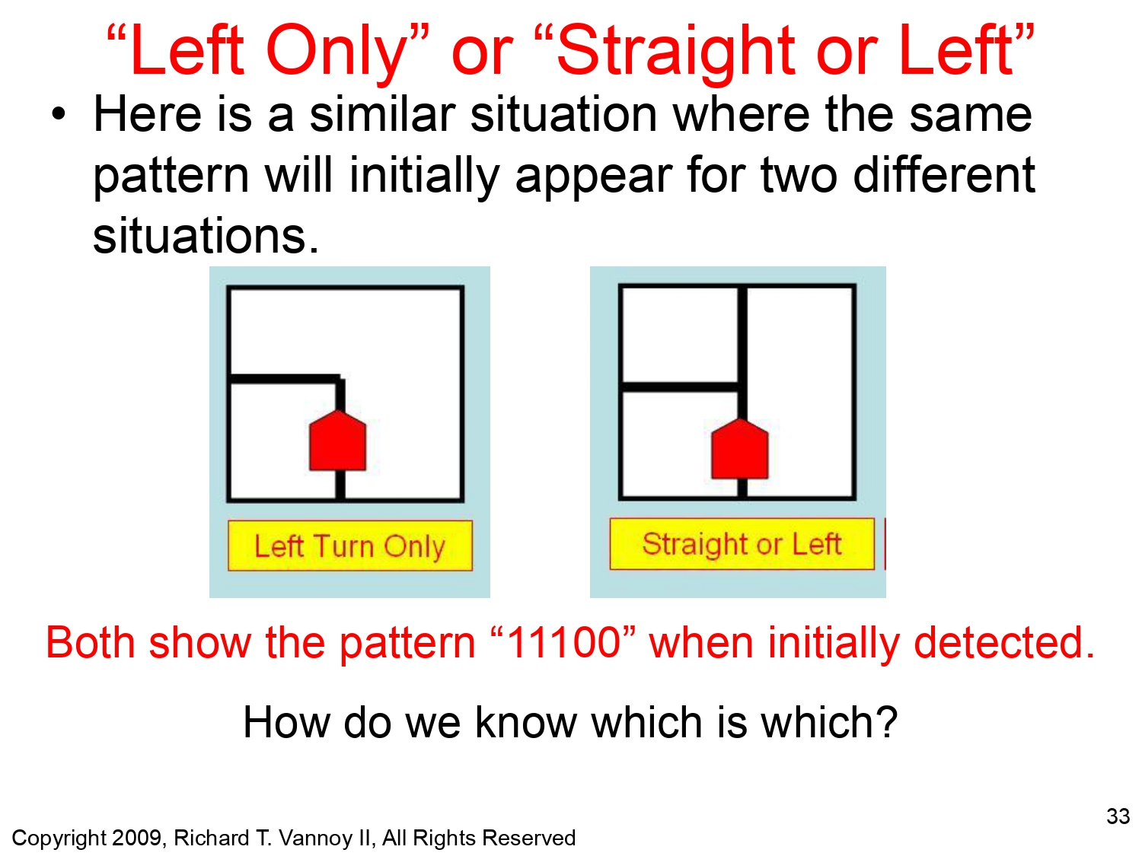
Left hand Rule Algorithm

Slide 22
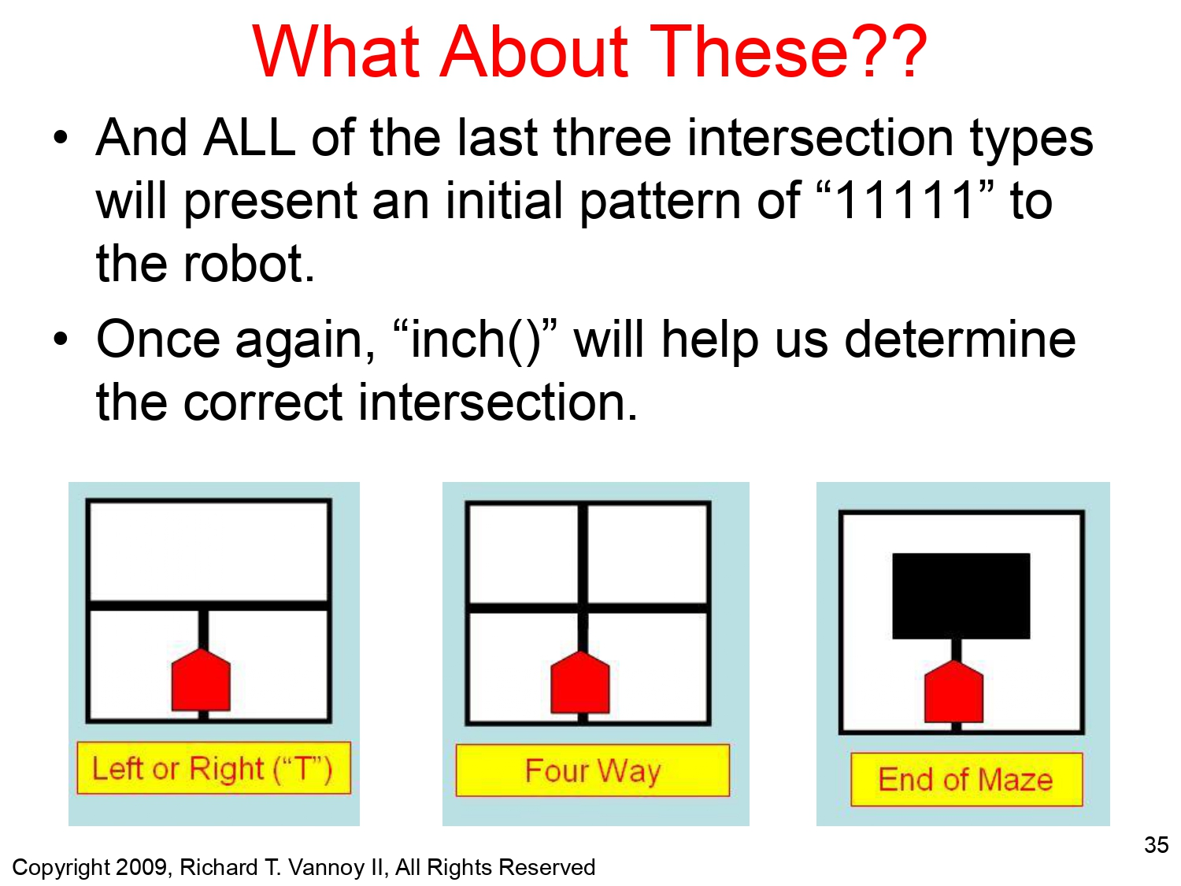
Left hand Rule Algorithm

Slide 23
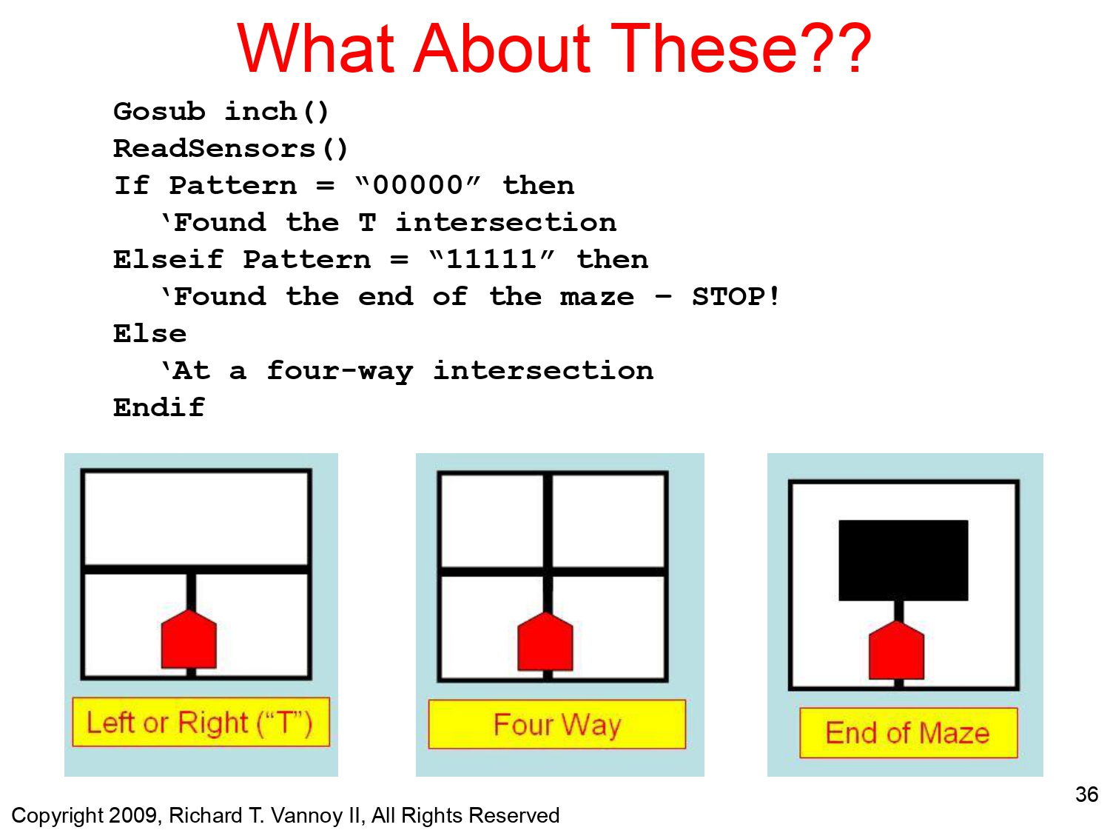
Left hand Rule Algorithm

Slide 24
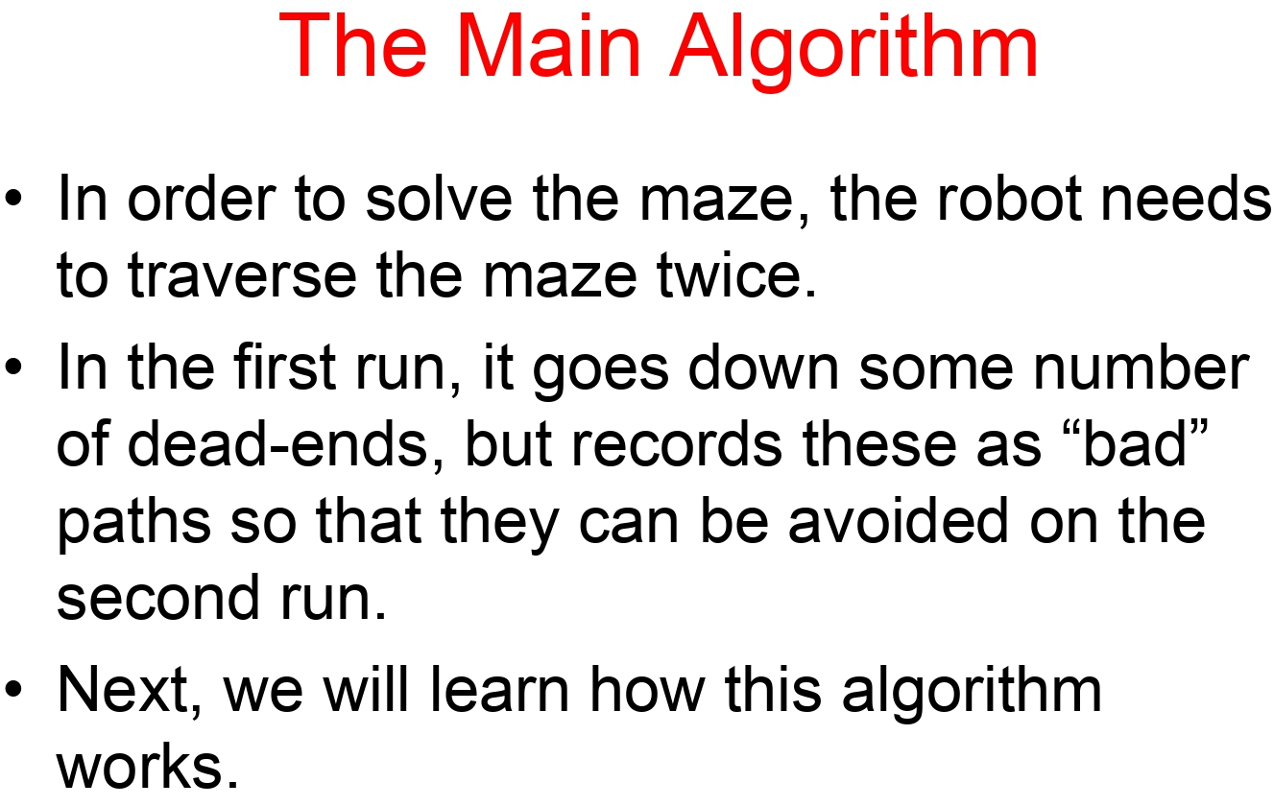
Left hand Rule Algorithm

Slide 25
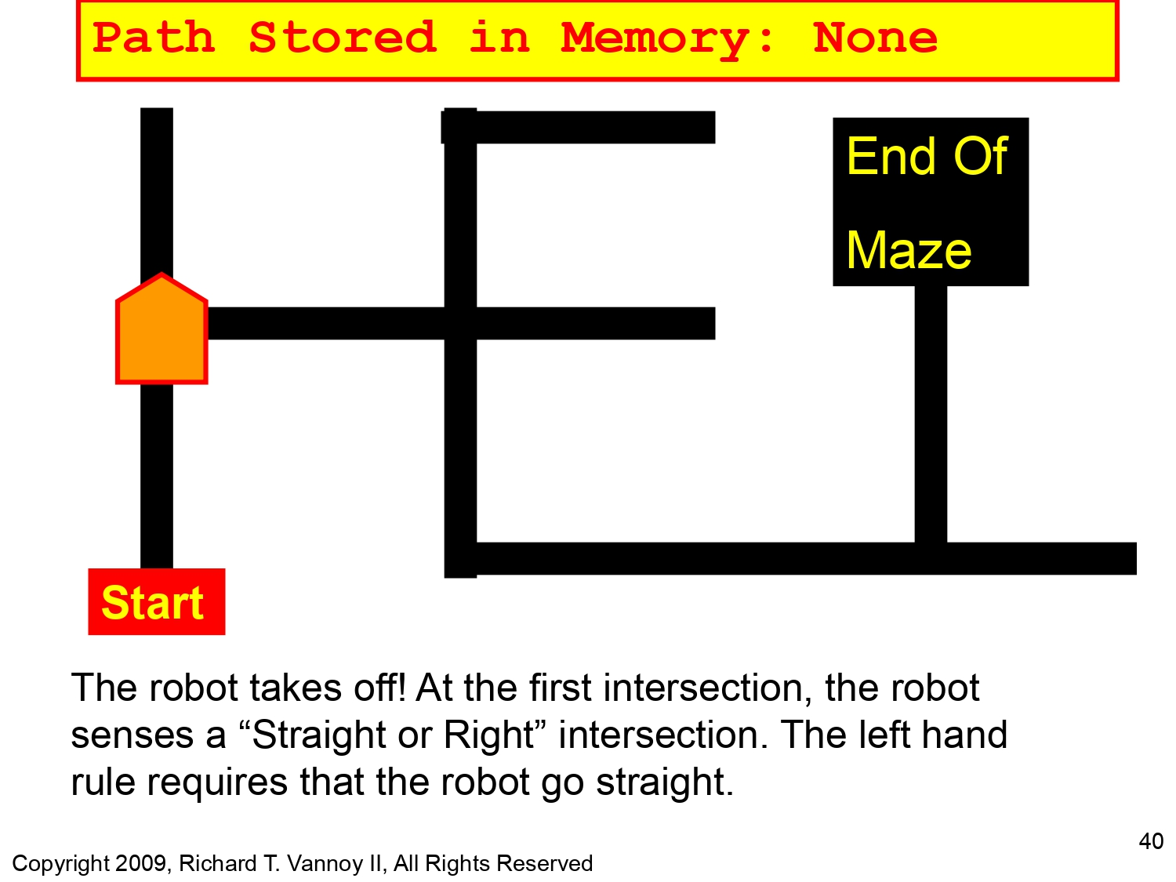
Left hand Rule Algorithm

Slide 26
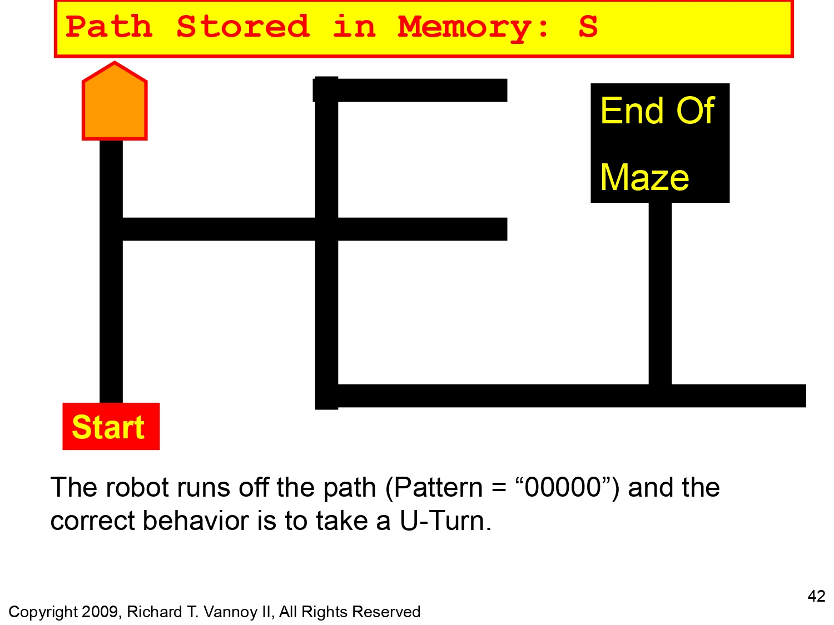
Left hand Rule Algorithm

Slide 27
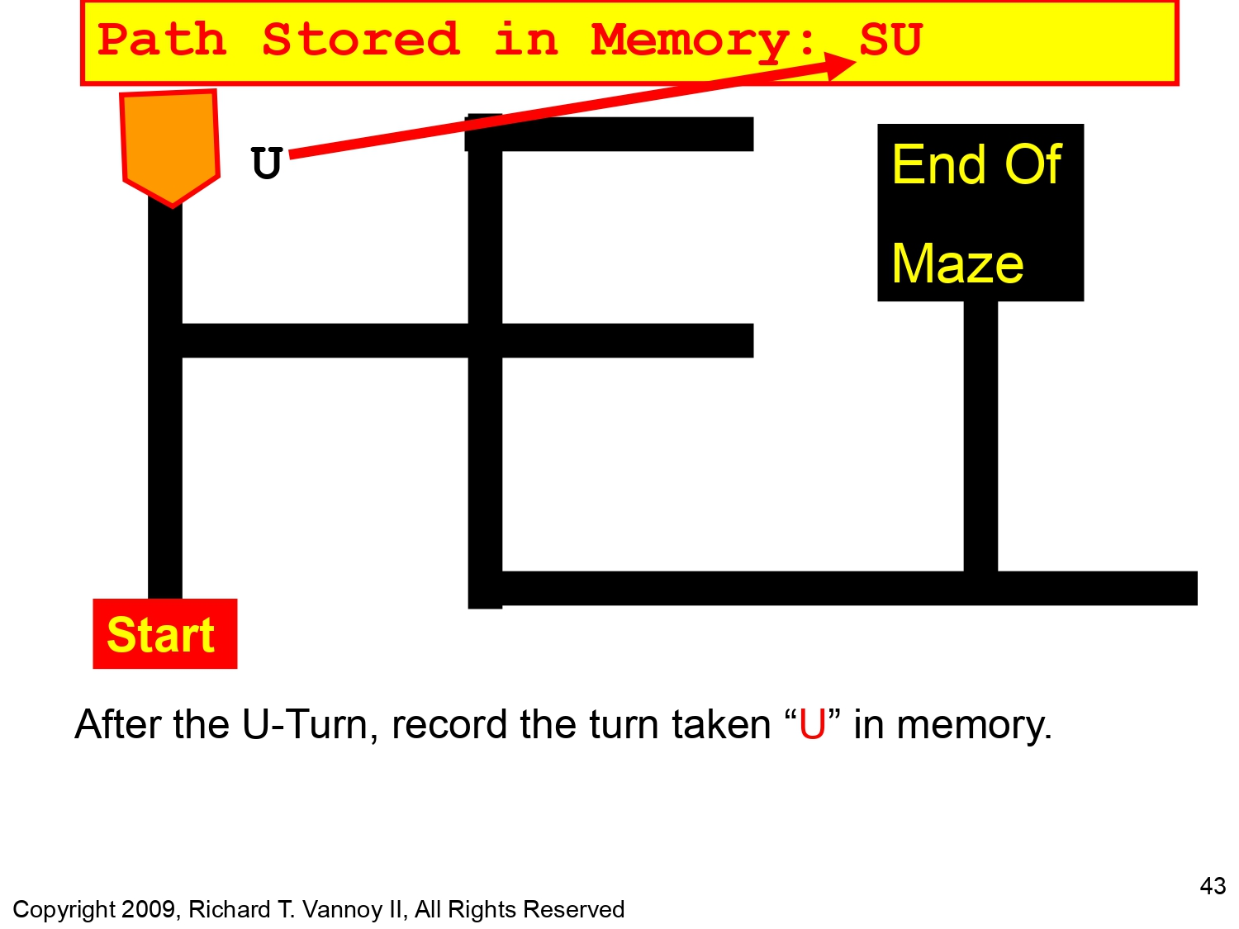
Left hand Rule Algorithm

Slide 28
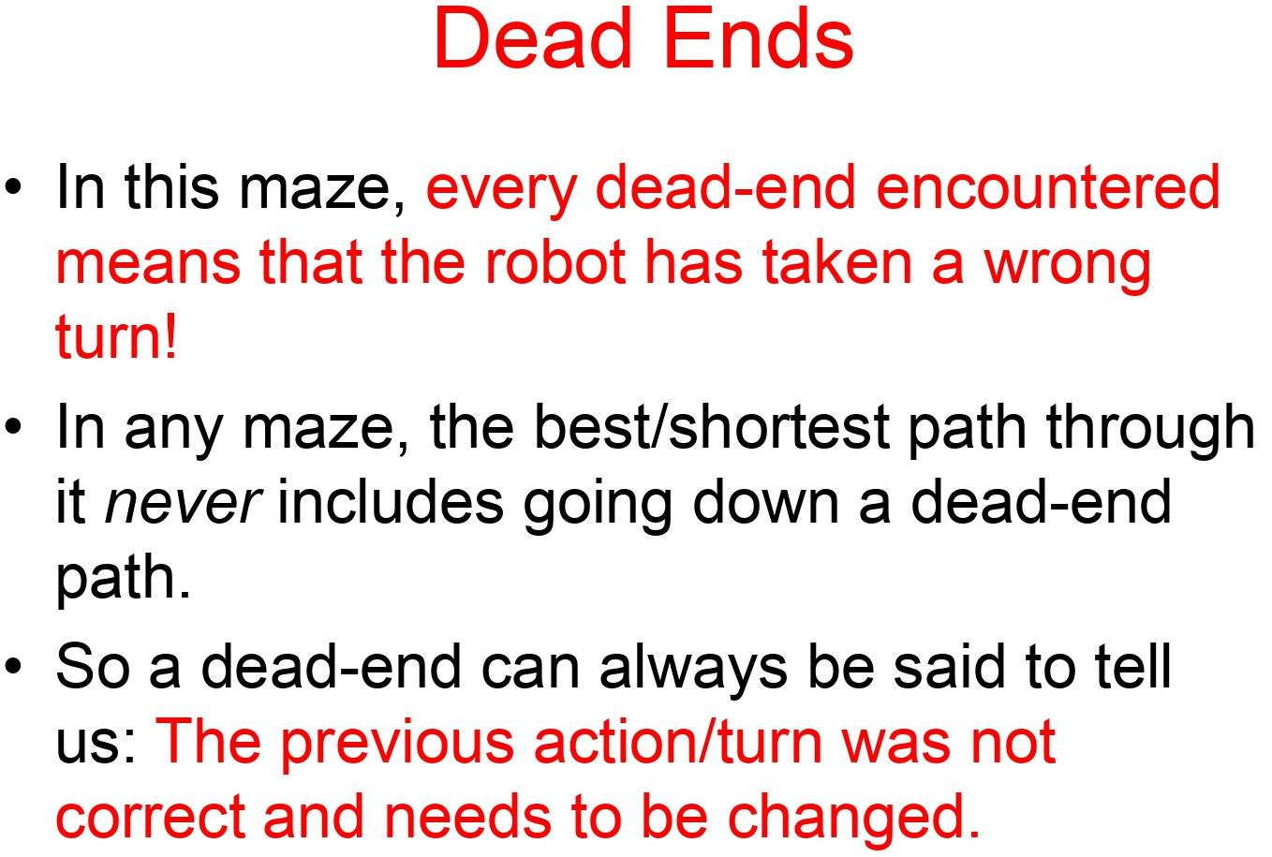
Left hand Rule Algorithm

Slide 29
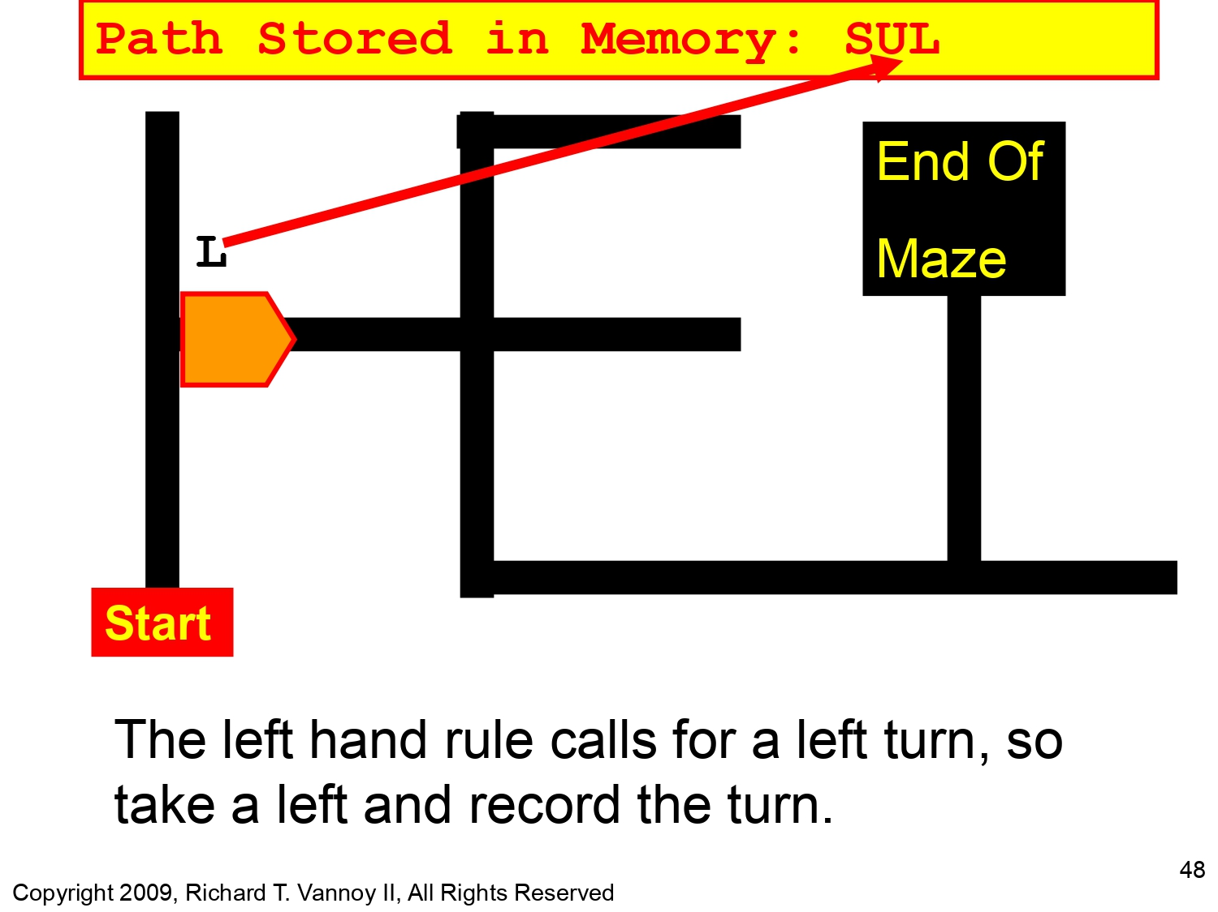
Left hand Rule Algorithm

Slide 30
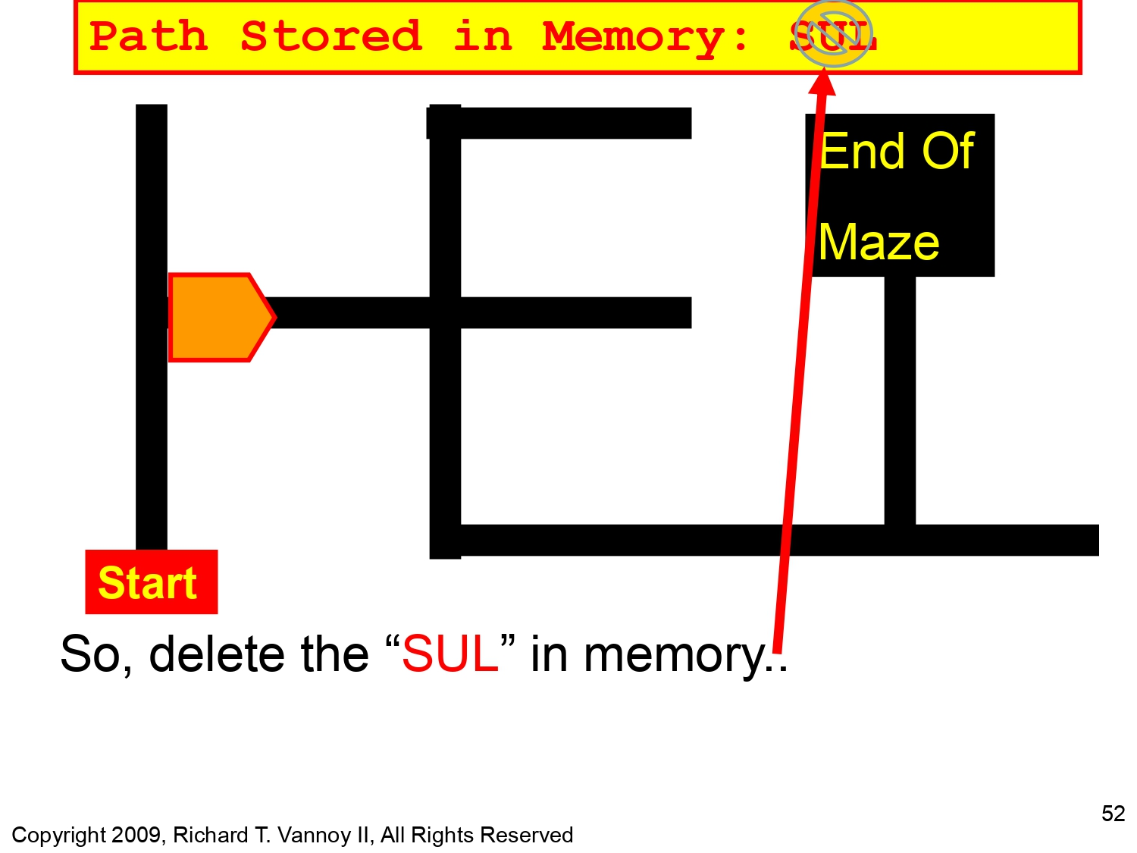
Left hand Rule Algorithm

Slide 31
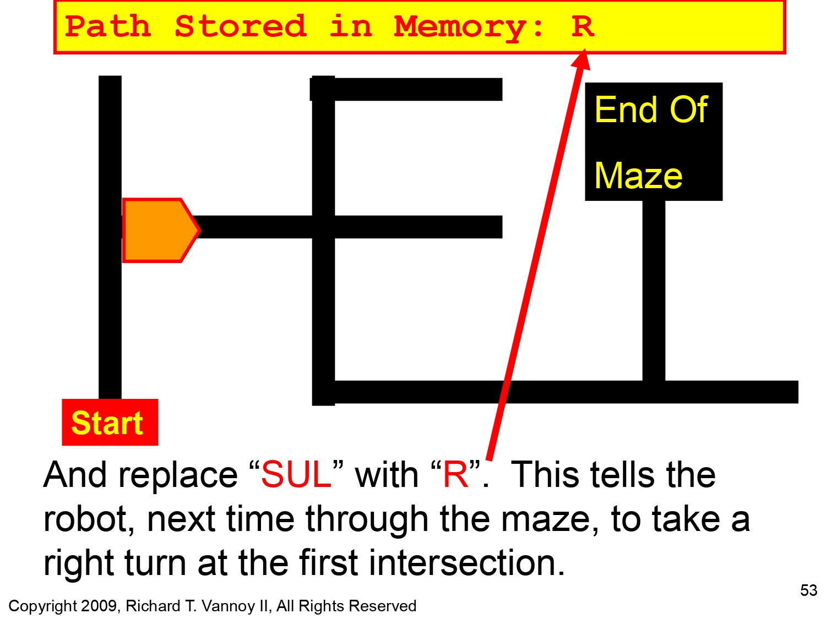
Left hand Rule Algorithm

Slide 32
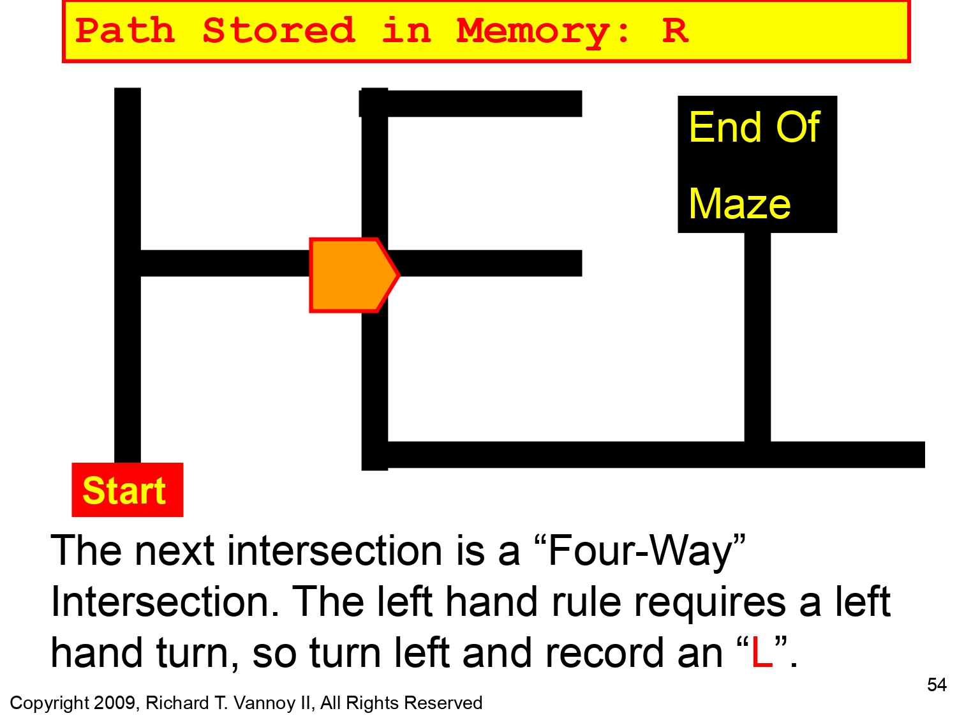
Left hand Rule Algorithm

Slide 33
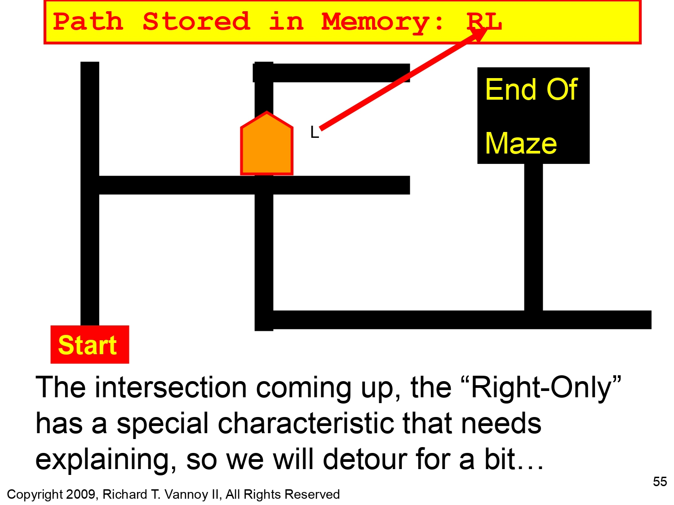
Left hand Rule Algorithm
For Right only and left only intersection we don't count it. (Not a real intersection.)

Slide 34
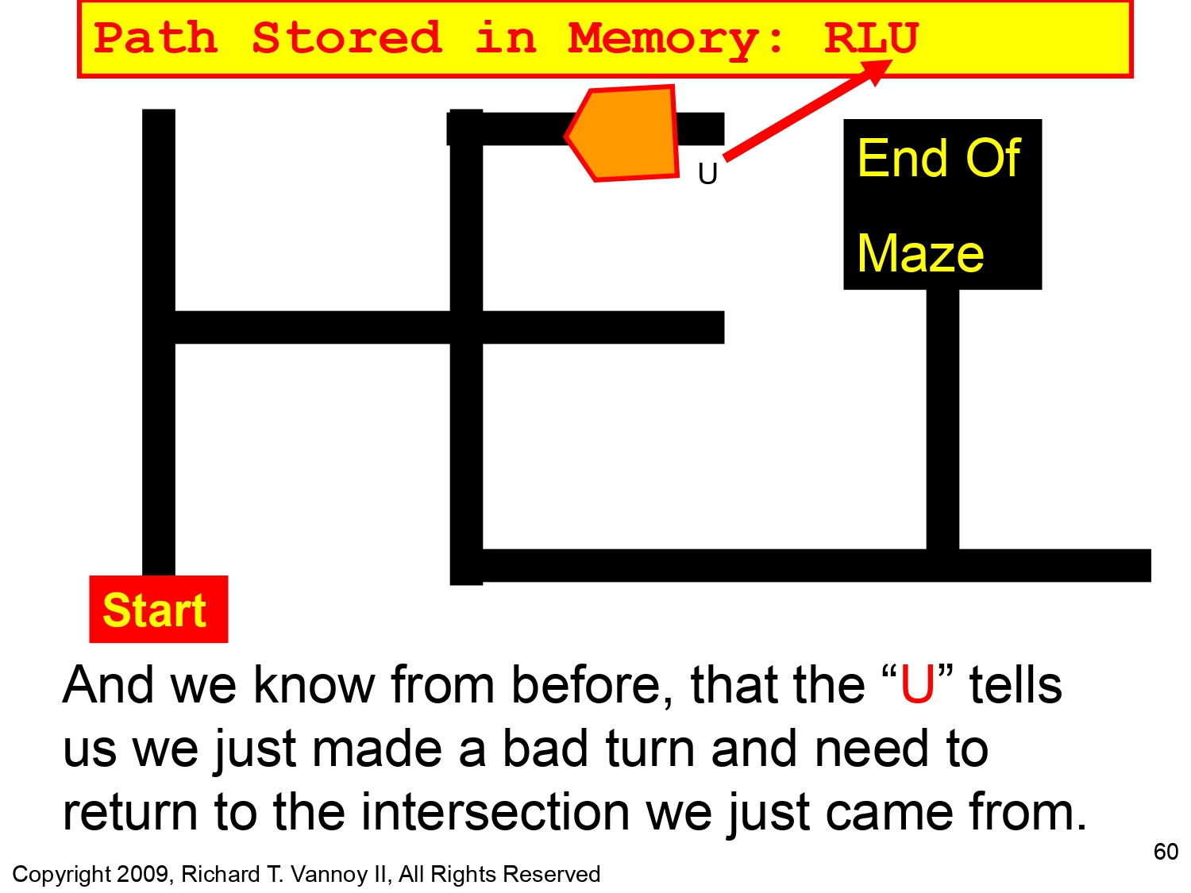
Left hand Rule Algorithm

Slide 35
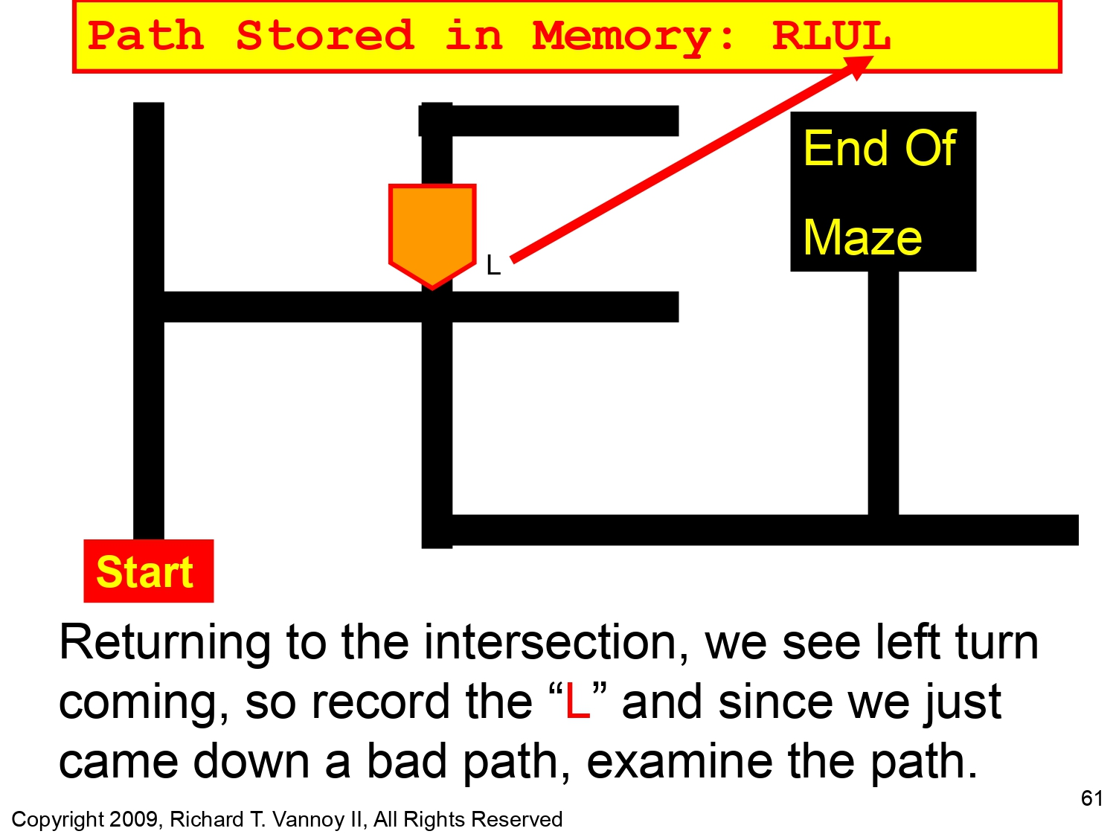
Left hand Rule Algorithm

Slide 36
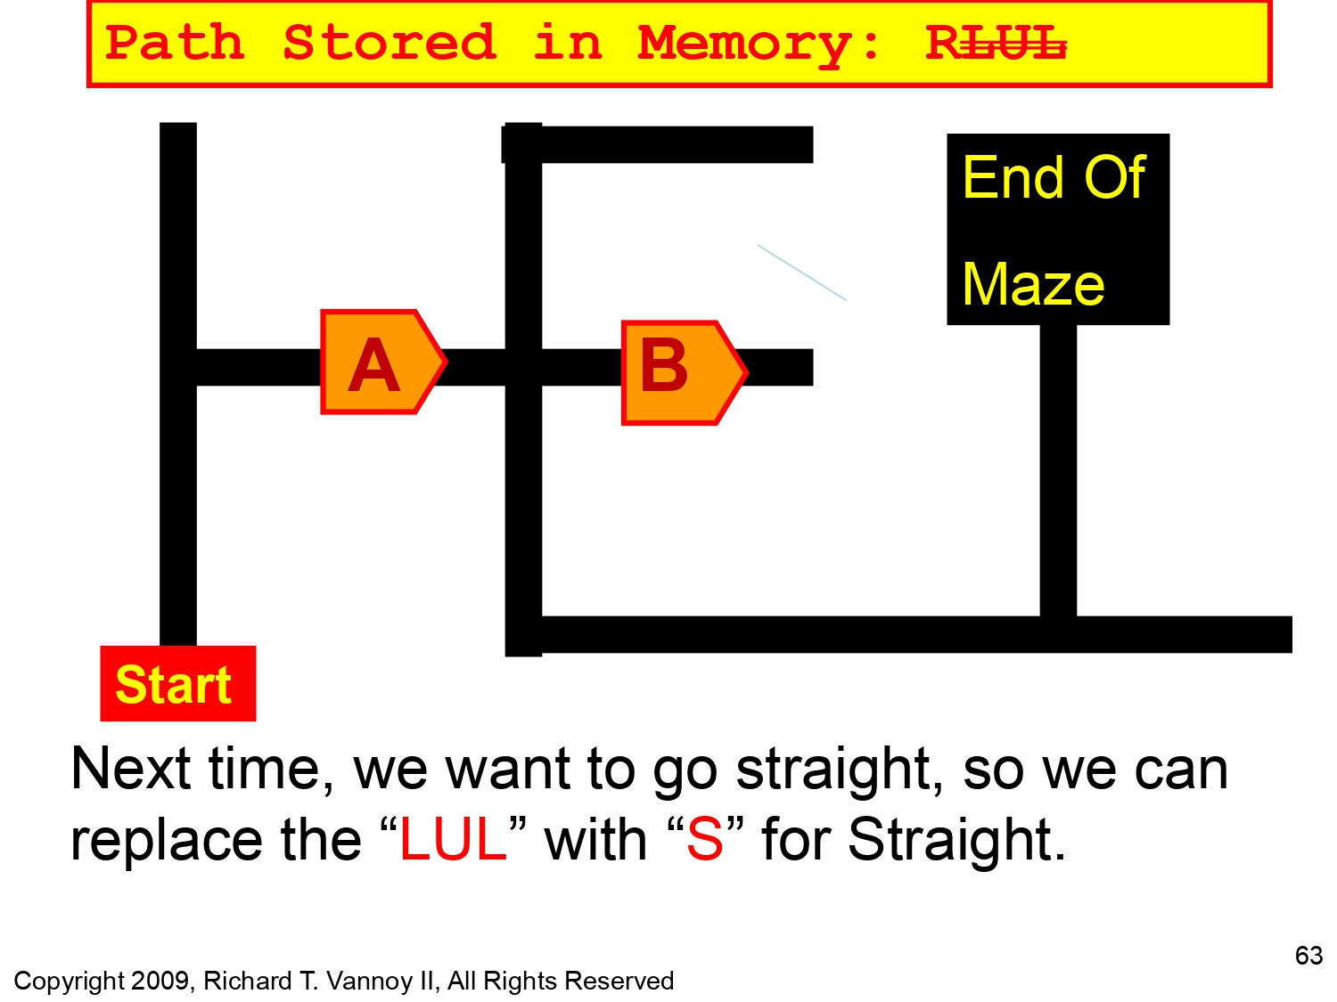
Left hand Rule Algorithm

Slide 37
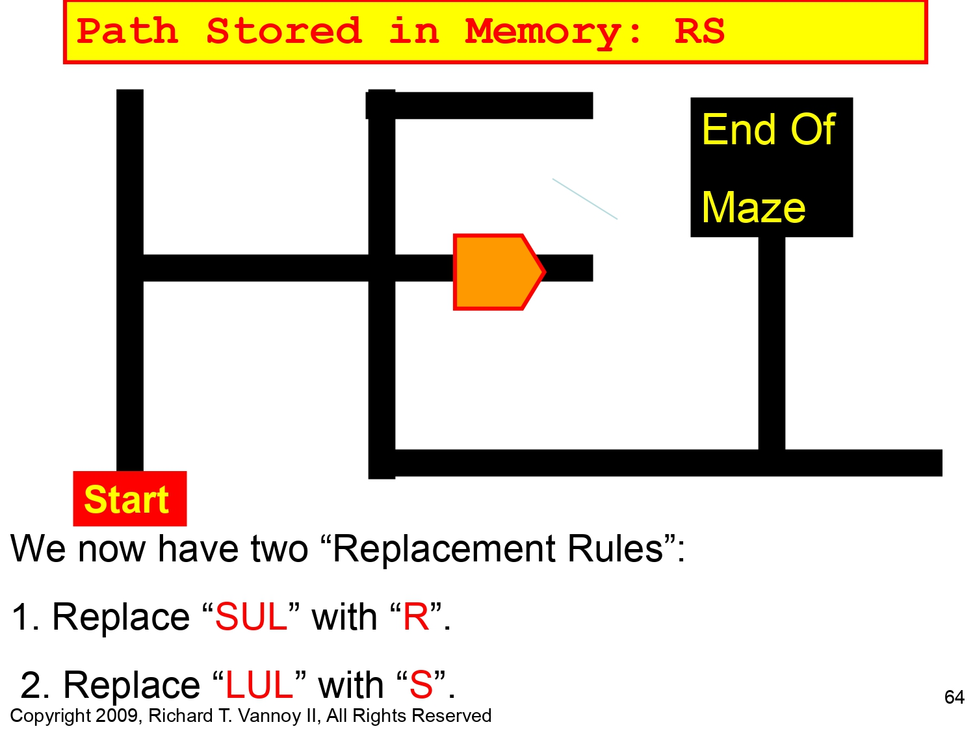
Left hand Rule Algorithm

Slide 38
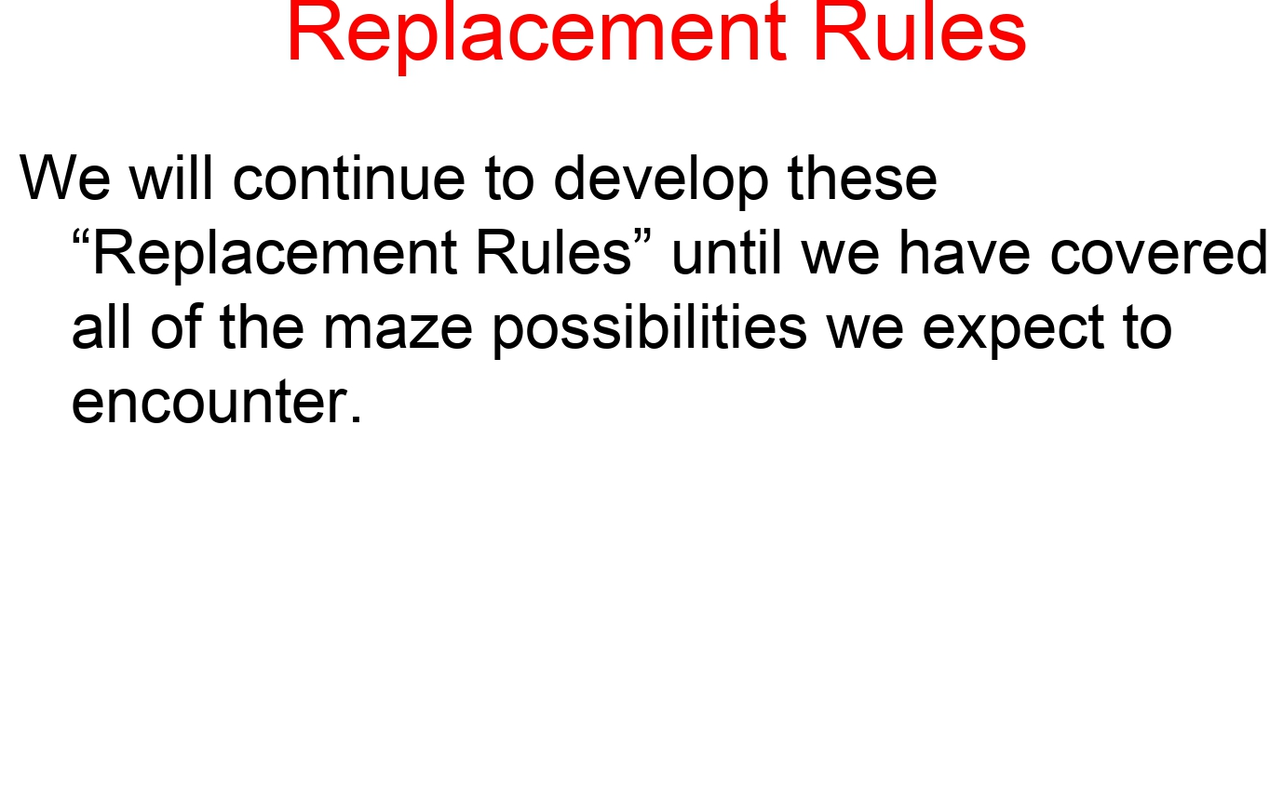
Left hand Rule Algorithm

Slide 39
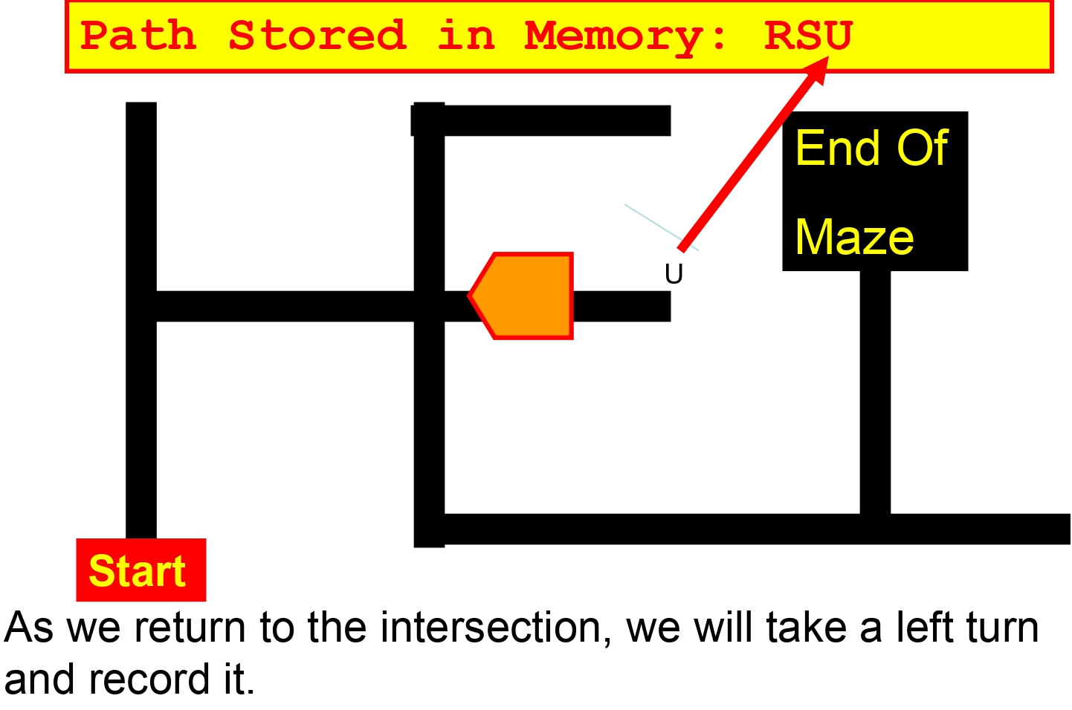
Left hand Rule Algorithm

Slide 40
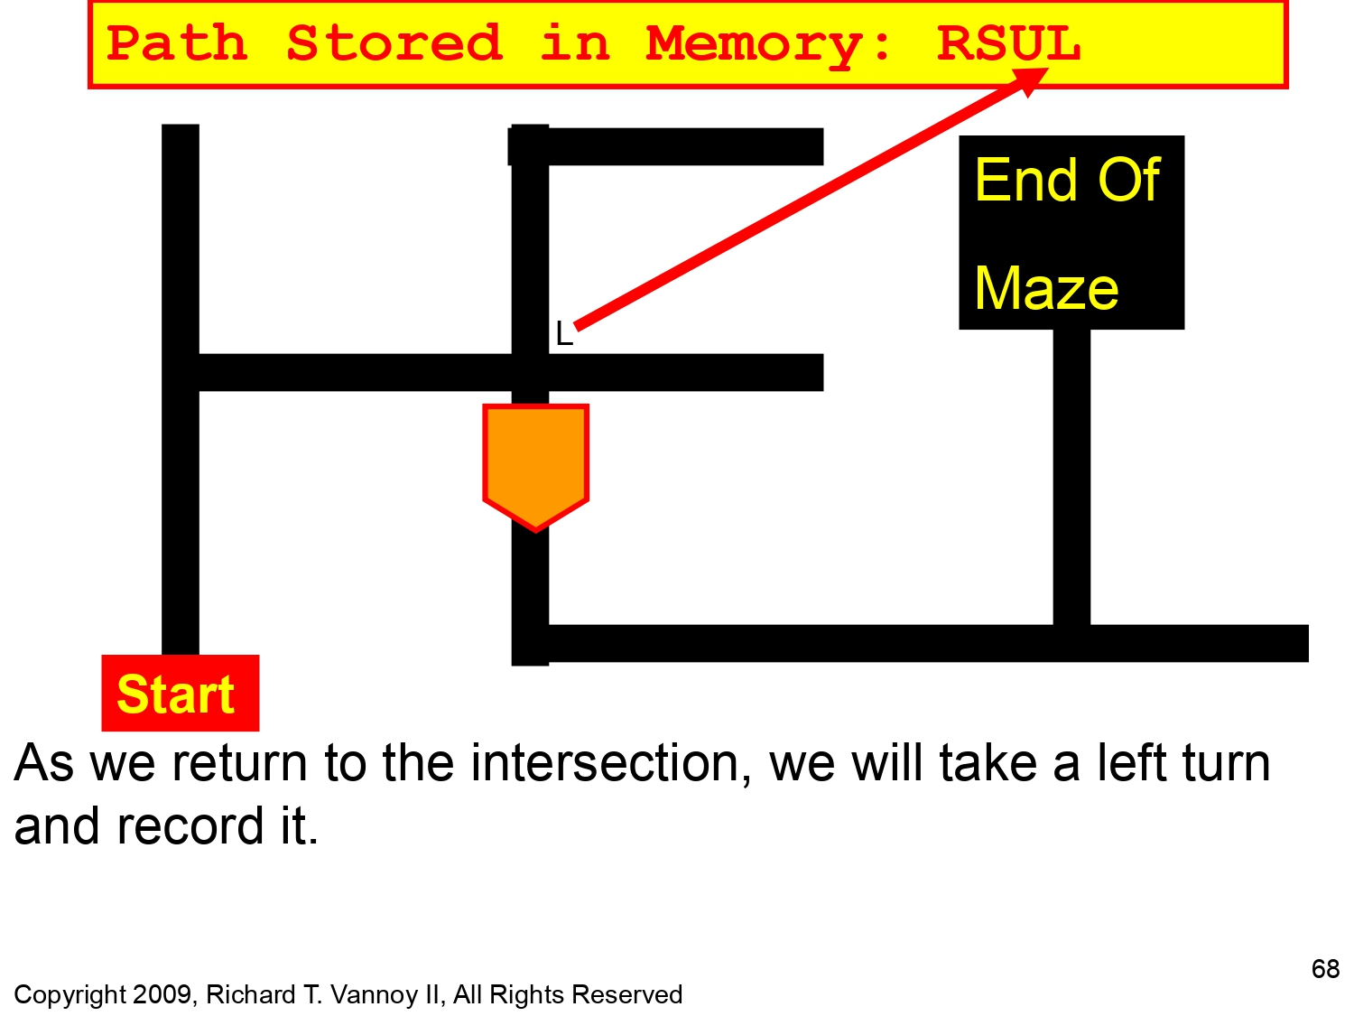
Left hand Rule Algorithm

Slide 41
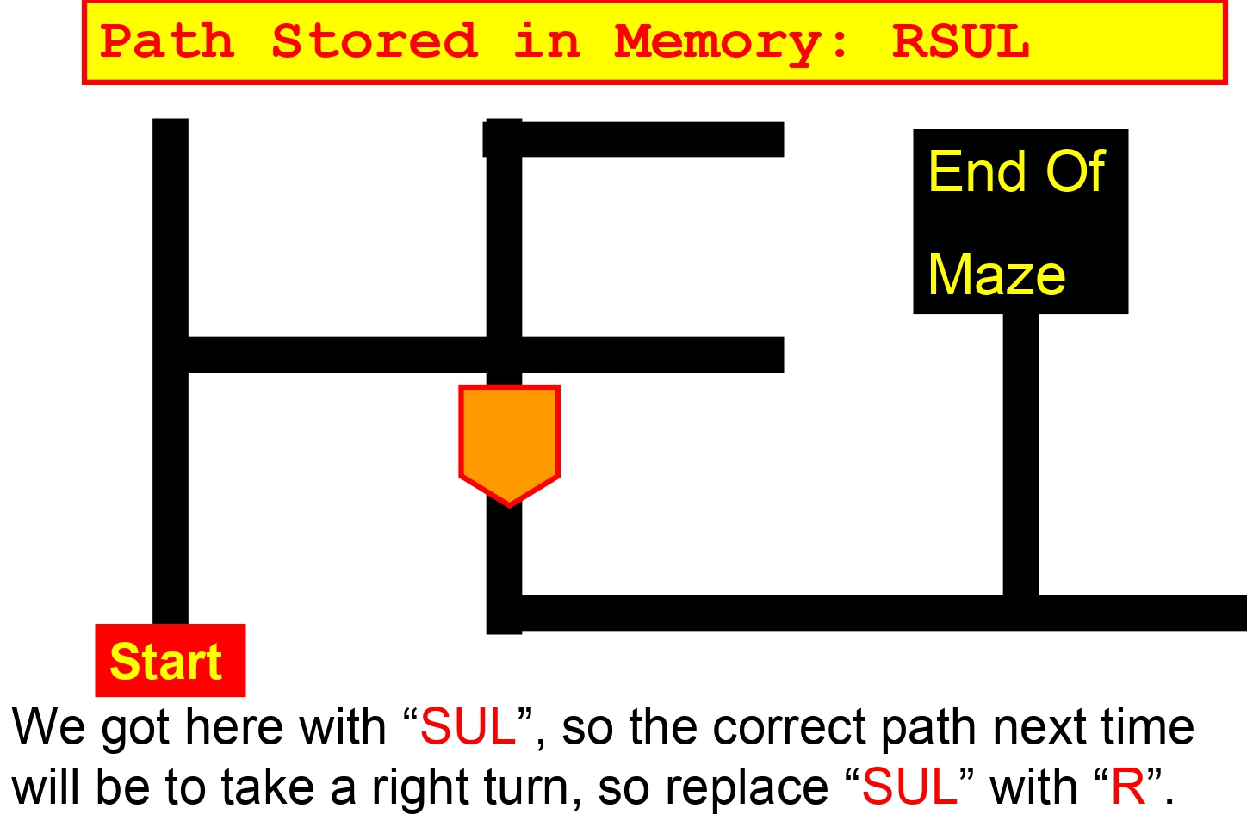
Left hand Rule Algorithm

Slide 42
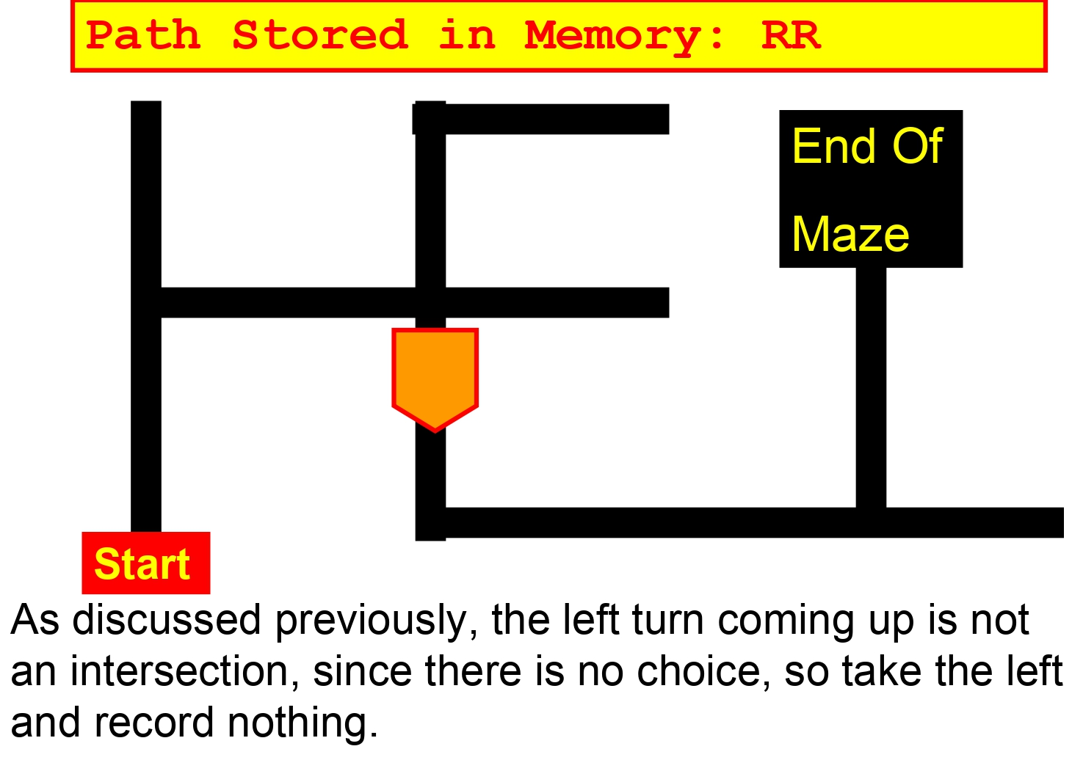
Left hand Rule Algorithm

Slide 43
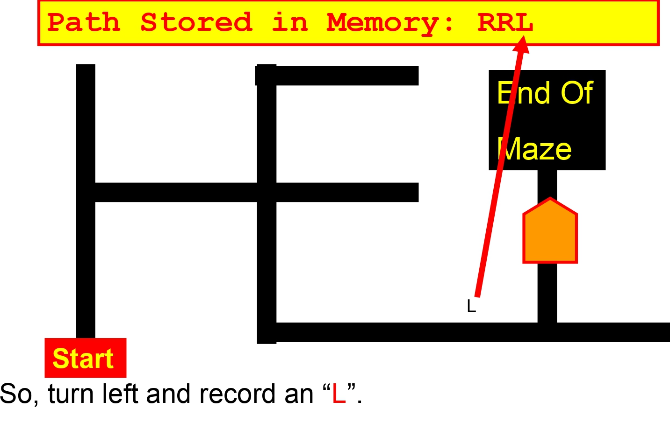
Left hand Rule Algorithm

Slide 44
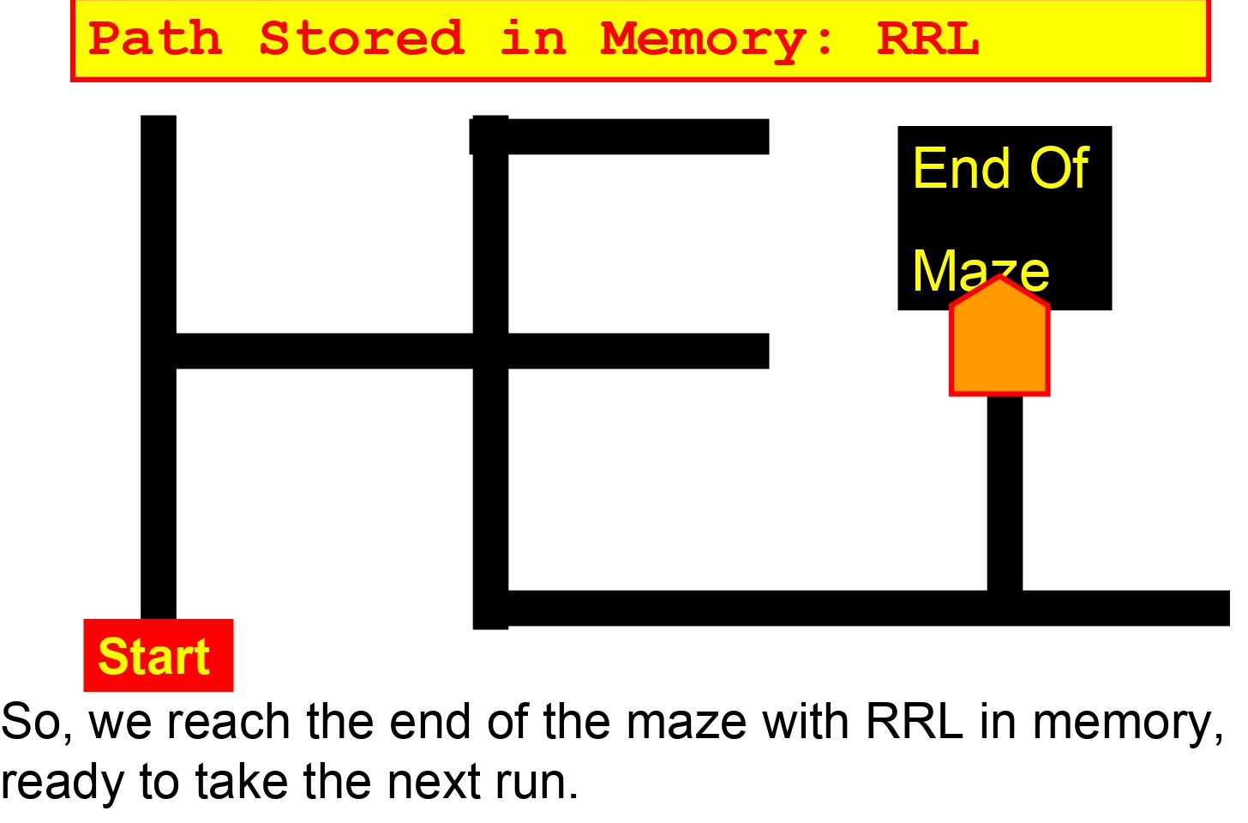
Left hand Rule Algorithm

Slide 45
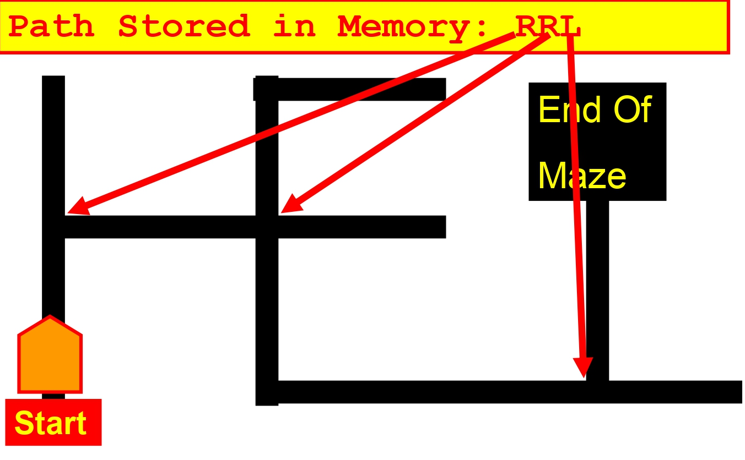
Left hand Rule Algorithm

Slide 46
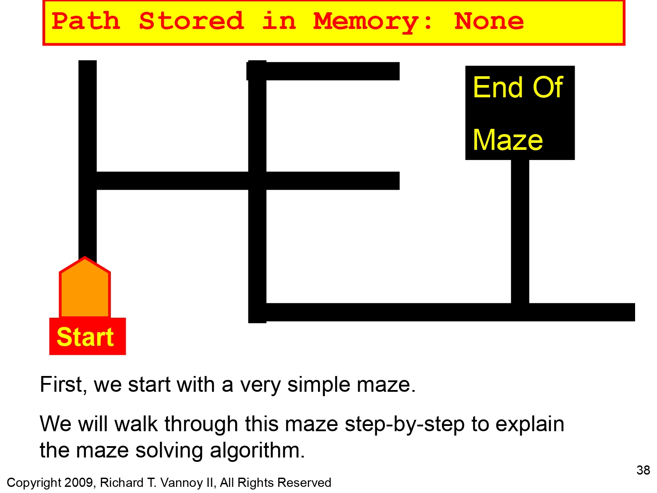
Memory part
Memory : SULLULULL.
We already know the rules :
ie we dont want U (U-turn ) in our code.
so check before and after of U
got 2 Rules :
SUL = R
LUL = S

Slide 47
Memory Part
In code , Memory = Array
so,
Psudo code :
while ('U' is present in array)
find 'U' in array;
store it location in a variable ;
make a variable and store 3 letters with U in between
(say SUL)
Now check the rule and change the letters in array .
0 1 2 3 4 5 6 7 8
S | U | L | L | U | L | U | L | L

Slide 48
Memory Part
SULLULULL
SULLULULL
SUL = R So,
RLULULL
LUL = L So,
RSULL
SUL = R So,
RRL = final
0 1 2 3 4 5 6 7 8
S | U | L | L | U | L | U | L | L

Slide 49
NOW YOU KNOW
This presentation is a “HOW TO DO COOKING” Presentation.
and not a “GIVE YOU THE FOOD” Presentation.
If you have any questions message me on whatsapp : 8434928102.
(Don't ask for source code.)
Line follower Bots Are mainly used for compitition so please make your own source code using these informations.

Slide 50




Thank you
From

